Slide 1
Dr. Sunirmal Khatua
Introduction to Cloud Computing
By
Visvesvaraya Young Faculty Fellow, Govt. of India
Assistant Professor, University of Calcutta
Notes:
We celebrate Christmas to remember the birth of Jesus Christ

Slide 2


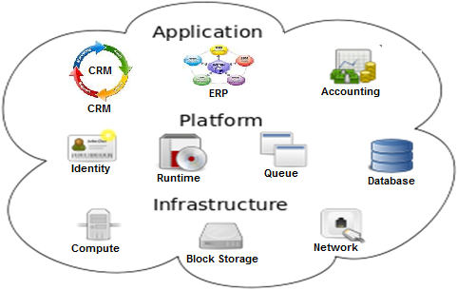



What is Cloud Computing?
According to NIST (National Institute of Standards and Technology)
Cloud Computing is a model for enabling convenient, on-demand network access to a shared pool of configurable computing resources that can be rapidly provisioned and released with minimal management effort or service provider interaction
Definition in AWS Academy
Cloud Computing is the on-demand delivery of compute power, database, storage, application, and other IT resources via the internet with pay-as-you-go pricing.
Infrastructure as Hardware (traditional)
Require space, staff, physical security, high capital expenditure (CAPEX) and low operational expenditure (OPEX)
Need capacity guessing
Infrastructure as Software (Cloud)
Easy and Flexible without capacity guessing
Can be changed quickly in a cost effective way
Eg. – Terraform Infrastructure as a Code (IaC)
Note: The term Cloud is a metaphor for the Internet

Slide 3
Characteristics of Cloud Computing
Characteristics of Cloud Computing:
On-demand Self Service
Broad Network Access
Multi-tenancy
Rapid Elasticity
Measured Service
Issues of Cloud Computing:
Inherent Latency
Security
Vendor Lock in

Slide 4
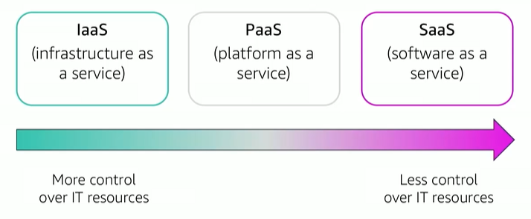
Cloud Service Models
Infrastructure as a Service (IaaS)
Computing, Storage, Network, OS and other infrastructures.
Example – Amazon EC2 (Elastic Compute Cloud)
Platform as a Service (PaaS)
Application development tools and middlewares
Example – Google AppEngine
Software as a Service (SaaS)
Configurable Applications
Example – Salesforce
001001110110101
Single Code base
SaaS Product
Customer A
Configuration Data
Customer B
Configuration Data
Application Data
Application Data
Configurable Computing Resources
Multi-tenancy

Slide 5
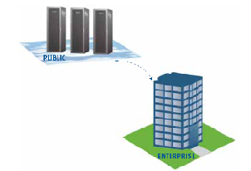
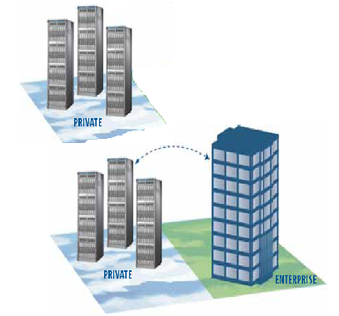
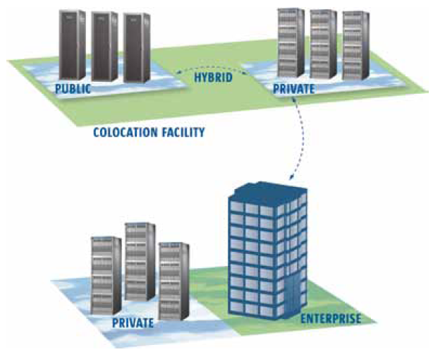
Cloud Deployment Models
Public Cloud
Private Cloud
Community Cloud
Hybrid Cloud

Slide 6

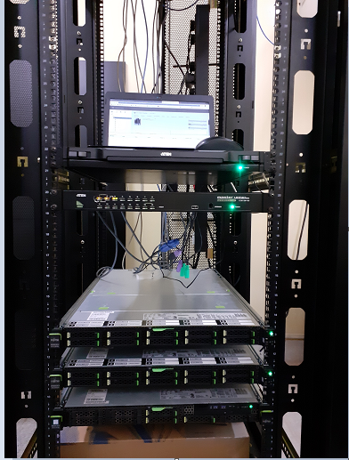
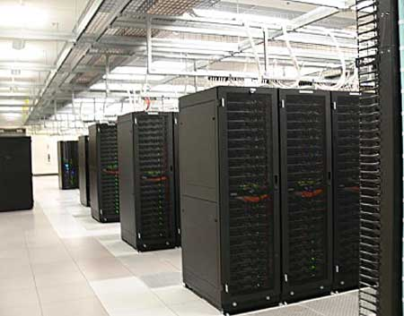
Accessing Cloud Resources
CLI
SDK
Web
Command Line Interface
Software Development Kit
Management Console
CU Cloud Lab

